Slide 1
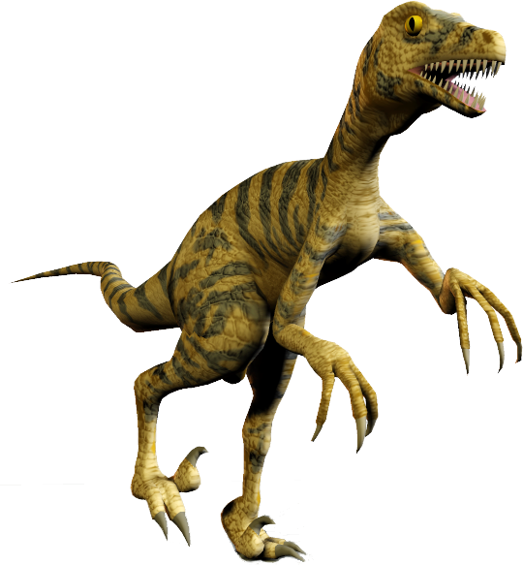

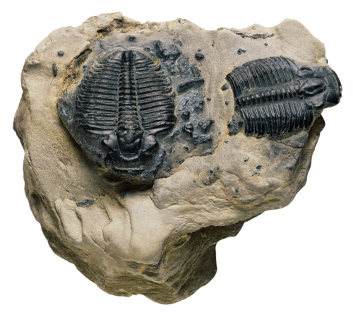

Evolution Series: Set 3
Copyright © 2005
Version: 2.0

Slide 2
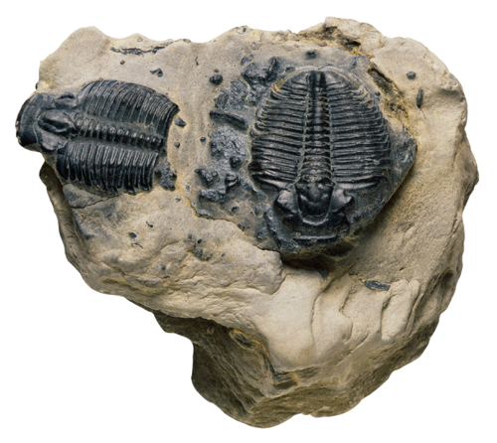
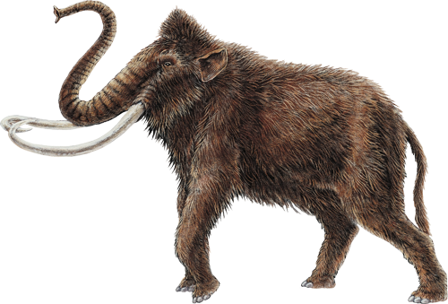
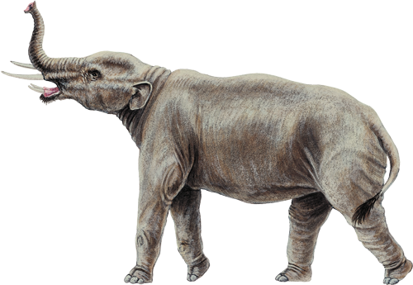
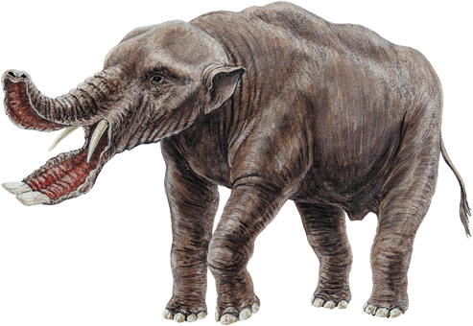

What is Evolution?
What is evolution?
  Evolution refers to the permanent genetic change (change in gene frequencies) in population of individuals.
  It does not refer to changes occurring to individuals within their own lifetimes. Populations evolve, not individuals.
Microevolution describes the small-scale changes within gene pools over generations.
Macroevolution is the term used to describe large scale changes in form, as viewed in the fossil record, involving whole groups of species and genera.

Slide 3
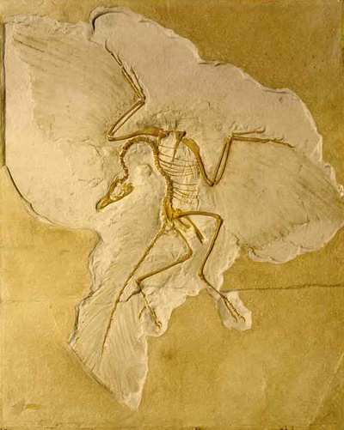
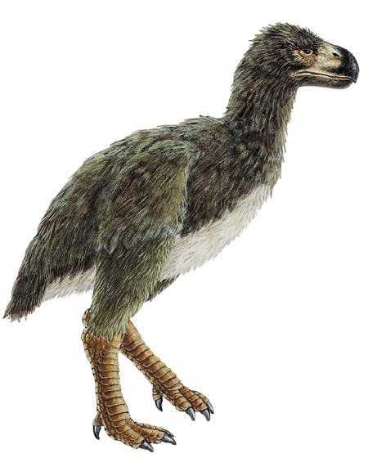
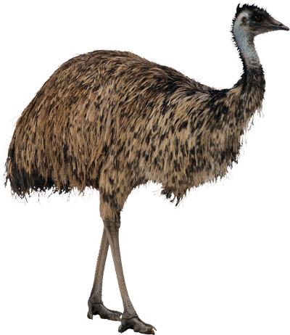
Macroevolution
Macroevolution includes:
  Adaptive radiation of groups of species into different environments and different niches.
  The origin of evolutionary novelties such as the wings and feathers of birds, and the upright posture of humans.
The evolutionary history of
a species or taxonomic group
is called its phylogeny.
  Classification of species aims to accurately reflect their phylogeny.

Slide 4
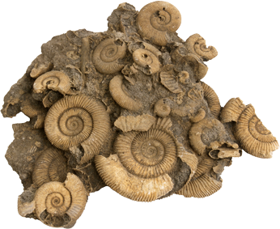
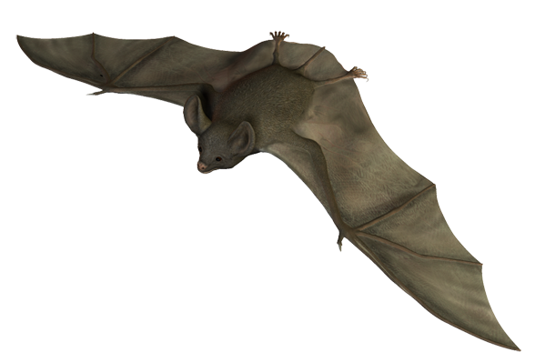

Evidence for Evolution
Evolutionary theory is now supported by a
wealth of observations and experiments.
Although biologists do not always agree on the mechanisms by which populations evolve, the
fact that evolution has taken place is well documented.
Evidence for evolution comes from many sources:
  Paleontology: The identification,
  interpretation and dating of fossils
  gives us some of the most direct
  evidence of evolution.
  Embryology and evolutionary developmental
  biology: The study of embryonic development
  in different organisms and its genetic control.
  Comparative anatomy:
  The study of the morphology
  of different species.
Paleontology
Comparative anatomy

Slide 5
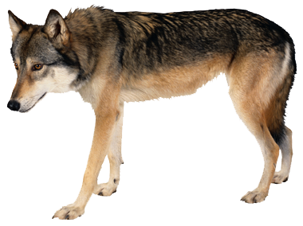
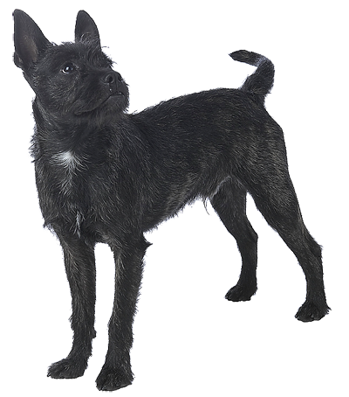
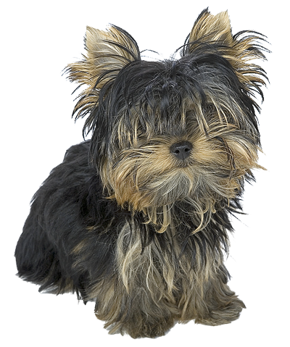
Evidence for Evolution
  Biogeography: The study of geographic distributions can indicate where species may have originally arisen.
  Artificial selection: Selective breeding of plants and animals has shown that the phenotypic characteristics of species can change over generations as particular traits are selected in offspring.
  Biochemistry: Similarities and differences in the biochemical make-up of organisms can closely parallel similarities and differences in appearance.
  Molecular genetics: Sequencing of DNA and proteins indicates the degree
  of relatedness between organisms.
From gray wolf to Yorkshire terrier: selective breeding can result in phenotypic change

Slide 6
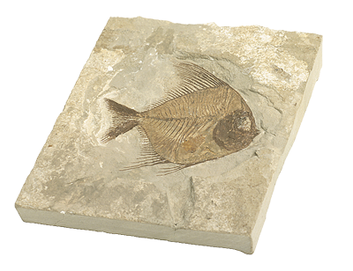
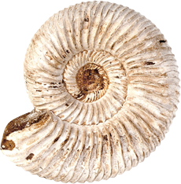
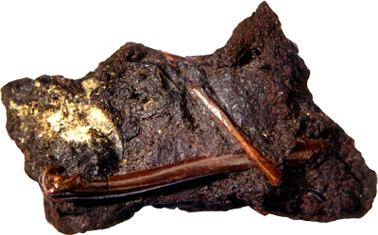
Types of Fossils
Fossil fish
The term fossil refers to any parts or impressions of an organism that may survive after its death.
  Fossils form best when
  organisms are buried quickly
  in conditions that slow the
  process of decay.
  Fossils are most commonly
  found in sedimentary rock.
  Mineral-rich hard parts (bones,
  teeth, shells) may remain as fossils,
  or minerals dissolved in water, may
  seep into tissues and replace
  the organic matter of the organism.
  On rare occasions, fossils retain organic
  material, as when plant material is compressed
  between layers of shale or sandstone.
Trilobites preserved in sedimentary rock
A layer of shell still covers the stone interior of this ammonite
Bird bones preserved in a tar pit

Slide 7
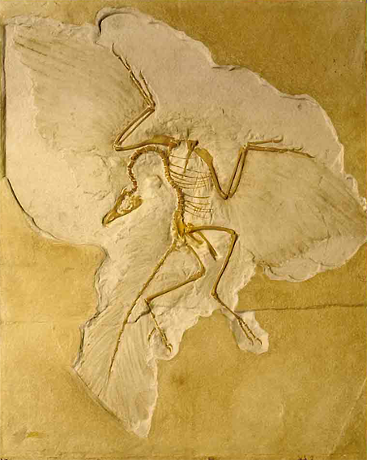
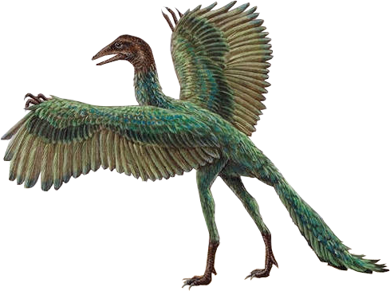
Interpretation of Fossils
The fossil record is an orderly array in which fossils appear in the layers, or strata, of sedimentary rocks.
When organisms are trapped in sediments, they record that moment in time.
  The fossils in each stratum of sedimentary rock are a local sample of the organisms that existed at the time the sediment was deposited.
  Because younger
  sediments overly older
  ones, it is possible to determine the relative
  ages of fossils.
This perfectly preserved skeleton of Archaeopteryx includes impressions of feathers on the forelimbs and tail

Slide 8
The Archaeopteryx Fossil
Eight well-preserved fossil specimens have been discovered in fine-grained limestone in Germany (dated late Jurassic, about 150 million years ago).
Reptilian Features
Avian Features
Forelimb has three functional fingers with grasping claws.
Vertebrae are almost flat-faced.
Lacks the reductions and fusions present in other birds.
Impressions of feathers attached to the forelimb.
Breastbone is small and lacks a keel.
Belly ribs.
True teeth set in sockets in the jaws.
Incomplete fusion of the lower leg bones.
The hind-limb girdle is typical of dinosaurs, although modified.
Impressions of feathers attached to the tail.
Long, bony tail.
LEFT: Archaeopteryx lithographica
Found in 1877 near Blumenberg, Germany

Slide 9
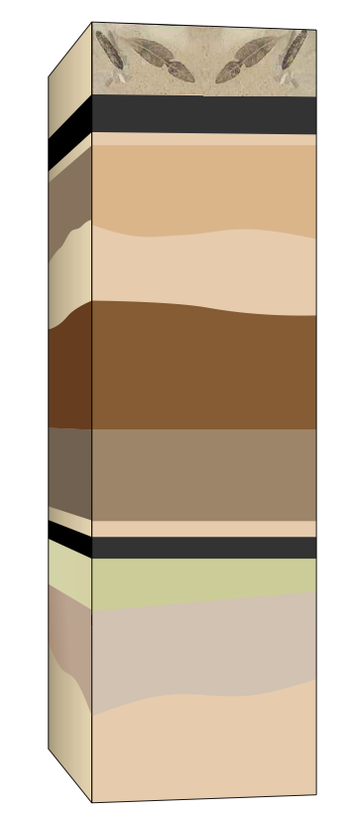

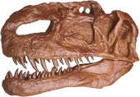

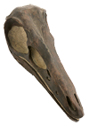

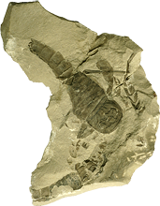
Fossils in a Rock Profile
Recent fossils are found in recent sediments
Layers of sedimentary rock are arranged in the order in which they were deposited, with the most recent layers nearer the surface.
  Sedimentary layers can be disturbed by subsequent tectonic activity.
The interpretation of rock layers containing fossils allows us to arrange the fossils in chronological order (order of occurrence), but does not give their absolute date.
Most recent sediments
Numerous extinct species
Fossil types differ in each sedimentary rock layer
New fossil types mark changes in environment
Oldest sediments
Only primitive fossils are found in older sediments

Slide 10
Dating Fossils
The relative age of fossils is useful, but fossils provide reliable historical data only if we can determine their absolute age.
A number of methods are used to date fossils.
Dating Method | Age Range (years) | Material Dated
Electron Spin Resonance | 500 000 – 1000 | Bone, tooth enamel, cave deposits
Fission Track | 1 million – 100 000 | Volcanic rock
Obsidian Hydration | 800 000 – present | Obsidian (volcanic glass)
Amino acid racemization | 1 million – 2000 | Bone
Thermoluminescence | less than 200 000 | Pottery, fired clay, bricks, burned rock
Uranium/Thorium | Less than 350 000 | Bone, tooth dentine
Carbon 14 | 1000 – 50 000+ | Bone, shell, charcoal
Potassium/Argon | 10 000 – 100 million | Volcanic rocks
A fossil trilobite, a primitive arthropod that dwelled in the seas of the Devonian period 370 million years ago

Slide 11
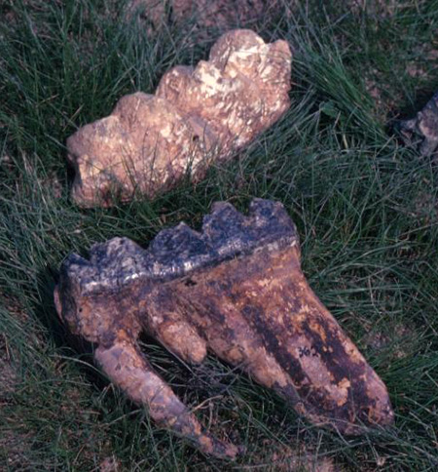
The Fossil Record
The fossil record is a substantial, but incomplete, record of evolutionary history:
  Modern species can be traced through fossil relatives to distant origins.
  Fossil species are often similar to, but usually differ from, today's species.
  Fossil types often differ between
  sedimentary rock layers.
  Numerous extinct species are found as fossils.
  Fossils can be dated to establish their approximate absolute age.
  New fossil types mark changes in the past environmental conditions on the Earth.
  Rates of evolution can vary, with bursts of species formation followed by stable periods.
These fossil teeth, from Mastodon, an extinct elephant, are similar to the deciduous teeth of modern elephants.

Slide 12
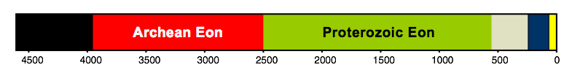
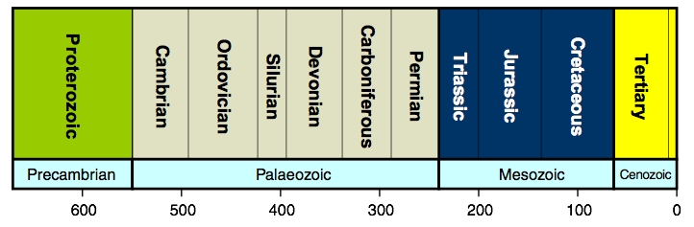
The History of Life on Earth
The history of life is divided up into eons, eras, periods, and epochs:
Formation of the earth
4600 mya
Oldest known microfossils found in 3500 million year old chert in Western Australia
Oxygen produced by plants accumulates in the atmosphere
Precambrian Eon
Millions of years ago
Quaternary
Eras
Millions of years ago

Slide 13
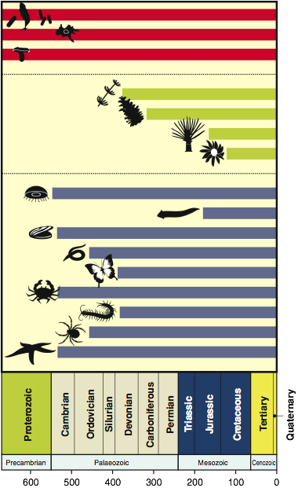
Evolutionary History 1
Based on fossil evidence and radio-isotope dating, the evolutionary history of plants, fungi, bacteria, protists, and non-chordate animals can be compiled.
  Bacteria, protists, and fungi have an evolutionary history extending back to the Precambrian.
  Some invertebrate groups extend back to the Cambrian Period, but land plants only as far back as the Devonian Period.
Bacteria and algae
Protists
Fungi
Sphenophytes (ferns etc)
Land plants
Conifers
Cycads
Angiosperms
Cnidarians
Flatworms
Molluscks
Annelid worms
Invertebrates
Insecta
Crustacea
Diplopoda
Arachnids
Echinoderms
Millions of years ago

Slide 14
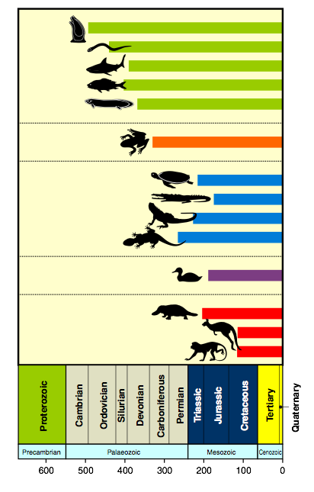
Evolutionary History 2
Similarly, the evolutionary history of chordates can be traced back to the Cambrian, but most animal groups are much more recent than this.
Tunicates
Agnatha (jawless fishes)
Sharks and rays
Ray finned fishes
Fish
Lungfish
Amphibians
Amphibians
Chelonia (turtles a& tortoises)
Reptiles
Crocodilia
Rhyncocephalia (tuatara)
Squamata (lizards & snakes)
Birds
Birds
Monotremes
Mammals
Marsupials
Placentals
Millions of years ago

Slide 15
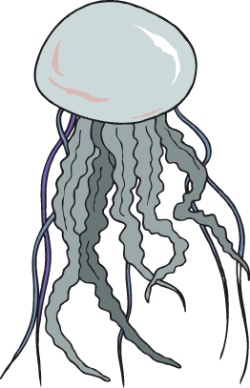
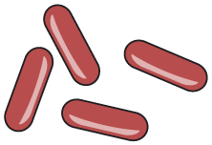
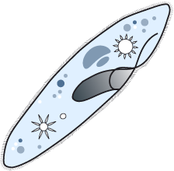
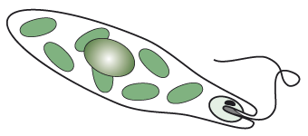
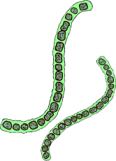
Precambrian Life
Cnidarians
4600 mya: Origin of Earth.
4600–3800 mya: Chemical and molecular evolution leading to origin of life: protocells to anaerobic bacteria.
3800–2500 mya: Origin of photosynthetic bacteria.
2500–570 mya: Origin of protists, fungi, algae, and animals.
Bacteria
Protozoans
Algae

Slide 16
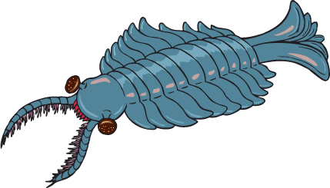
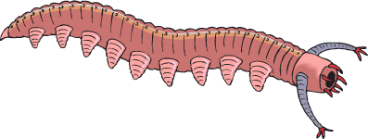
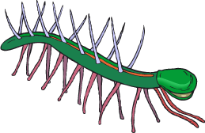
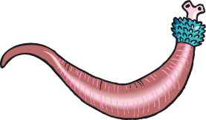
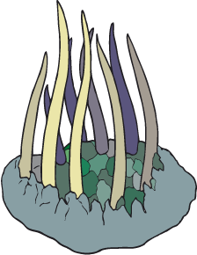
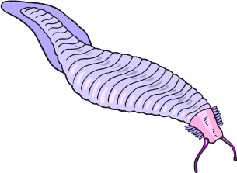
Early Paleozoic Life
550-500 mya: Origin of animals with hard parts, which appear as fossils in sedimentary rocks.
Simple marine communities become established.
The Burgess Shale deposits in Canada contain a rich collection of early Cambrian fossils.
  The fauna (pictured) was strange and, at first, wrongly interpreted.
Anomalocaris
Aysheaia
Hallucigenia
Ottoia
Pikaia
Wiwaxia

Slide 17

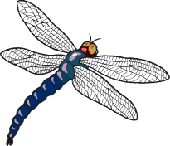
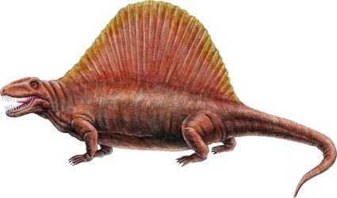
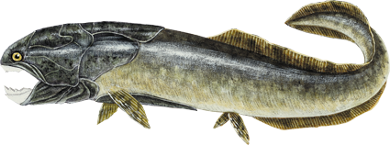
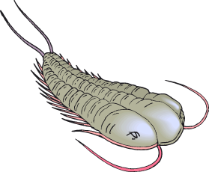
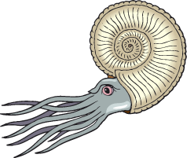
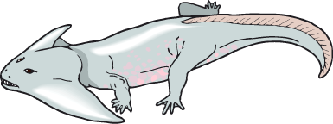
Late Paleozoic Life
Early vascular plants
500-435 mya: Major adaptive radiations of marine invertebrates and early fishes.
435-280 mya: Vast swamps with the first vascular plants. Origin and adaptive radiation of reptiles, insects, and spore bearing plants (including gymnosperms).
240 mya: Mass extinction of nearly all species on land and in the sea (the Permian extinction).
Early insects
Dimetrodon
Armored fish
Ammonite
Trilobite
Early amphibians

Slide 18
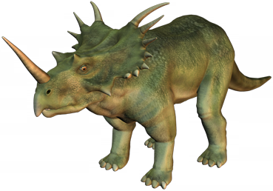
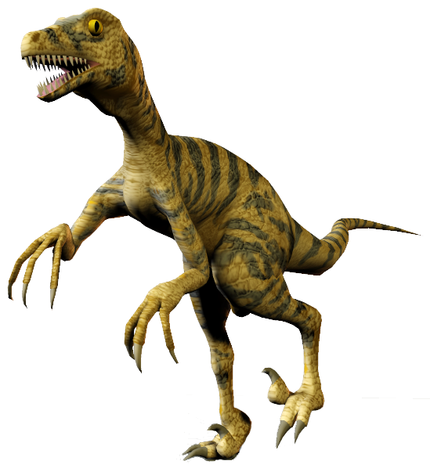
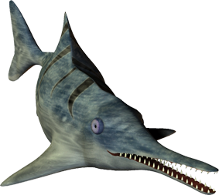
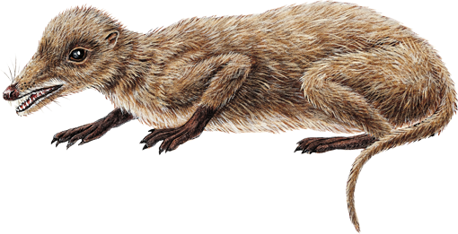
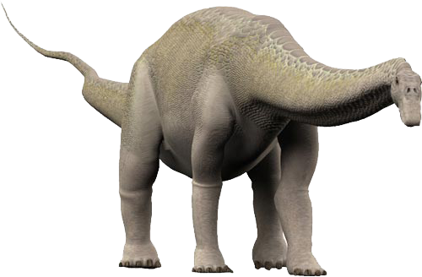

Mesozoic Life
240-205 mya: Recovery of surviving taxa and adaptive radiation of marine invertebrates, dinosaurs, and fishes. Origin of mammals. Gymnosperms become dominant land plants.
181-135 mya: Major radiations
of dinosaurs.
135-65 mya: Major radiations of dinosaurs, fishes, and insects. Origin of angiosperms.
65 mya: Asteroid impact linked to the mass extinction of many marine species and all dinosaurs (Cretaceous extinction).
Velociraptor
Styracosaurus
Icthyosaurus
Early mammals
Early gymnosperms
Apatosaurus

Slide 19





Cenozoic Life
65-1.65 mya: Major shifts in climate. Major adaptive radiations of angiosperms (flowering plants), insects, birds
and mammals.
3-5 mya: Early humans arise from ape ancestors.
1.65 mya: Modern humans evolve and their hunting and other activities accelerate.
Indricotherium
Glyptodon
Platybelodon
Diatryma
Dryopithecus
Sabretooth Tiger

Slide 20




















Comparative Embryology
When we compare the embryonic development of different vertebrates, it is evident that more closely related forms continue to appear similar until a later stage, compared to more distantly related forms.
Note that although the early developmental sequences between all vertebrates are similar, phylogeny is not retraced during development.
Developmental Stage | Amphibian | Bird | Monkey | Human
Fertilized egg
Late cleavage
Body segments
Limb buds
Late fetal
Gill slits

Slide 21

Comparative Anatomy
Forelimb
Hind Limb
The pentadactyl
(5 digit) limb found in most vertebrates has the same general bone structure.
This similarity of structure is called homology.
Homologies are indicative of common ancestry.
Humerus
(upper arm)
Femur (thigh)
Ulna
Fibula
Radius
Tibia
Carpals
(wrist)
Tarsals
(ankle)
Metacarpals
(palm)
Metatarsals
(sole)
Phalanges
(fingers)
Phalanges
(toes)
Note that forelimbs and hind limbs have different names for equivalent bones.

Slide 22






Homologous Structures
In many vertebrates, the basic pentadactyl limb has been highly modified to serve specialized locomotory functions.
Such homologies also indicate adaptive radiation, as the basic limb plan has been adapted to meet the needs of different niches.
The same pattern of bones comprising the pentadactyl limb can be seen on each of these examples.
Bird's wing
Mole's forelimb
Dog's front leg
Bat's wing
Seal's flipper
Human arm

Slide 23




Analogous Structures
Not all similarities between species are inherited from a common ancestor.
Structures that have the same function in different organisms may come from quite different origins. This phenomenon is termed analogy.
Analogous structures do not
imply an evolutionary relationship,
but may indicate convergence. Examples:
  Eye structure in octopus and mammals.
  Wings in birds and butterflies.
  Fins in fish and flippers in mammals
Fins
Flippers
Wings

Slide 24






Analogy in Eye Structure
Eyes in cephalopods (such as octopus) and mammals have the same function and are structurally similar, but have evolved from different origins.
Mammalian eye
Iris
Lens
Cornea
Retina
Octopus eye
Retina
Iris
Lens
Cornea

Slide 25


Vestigial Organs
Many organisms have degenerate structures that no longer perform the same function as in other organisms.
These organs must have been important in some ancestral form, but became redundant in later species.
The selection pressure for complete loss is weak
so the structures remain in a reduced form.
Although vestigial organs apparently
have little use, they may perform some
secondary function.
  The wings of kiwi are tiny vestiges and useless.
  In snakes, one lobe of the lung is vestigial
  and, in some species, there are also
  vestiges of the pelvic girdle and hind limbs.
  The vestigial eyes of burrowing animals are
  no longer used for vision.

Slide 26


Vestigial Organs in Whales
Whales are the descendants of large, four-legged land mammals that took up an aquatic existence some 60 million years ago.
Over many millions of years, the pelvis and femur of whales have become very small and no longer fulfill a locomotory function.
Femur
Pelvis
Hindlimb
Forelimb

Slide 27




Whale Ancestors
Cladogram of Whale Ancestors
The fossil record exhibiting whale evolution is extensive and well represented by skeletons that show much of their anatomy.
Black lines represent cladistic relationship (probable relatedness)
Pakicetus (Middle Eocene)
Protocetus (Eocene)
Basilosaurus (Late Eocene)
Red lines represents fossil record for the genus

Slide 28



Whale Ancestors
The fossils of the first cetaceans (Pakicetids), are only found in northern Pakistan and western India (see map). The Indian subcontinent is probably the region where cetaceans originated.
Pakicetids did not look like whales at all, and resembled land mammals.
The skulls of pakicetids have an ear region that is highly unusual in shape, and only resembles that of modern and fossil whales.
Photo, map and illustration courtesy of Hans Thewissen, NEOUCOM www.neoucom.edu/Depts/Anat/Pakicetid.html.
Prominent researcher into whale origins, Hans Thewissen, uses a toothbrush to clean a fossil at a site in Ganda Kas in Pakistan's Punjab Province. His group has been responsible for major fossil discoveries of whale ancestors in recent years.
A reconstruction of Pakicetus based upon their skeletons.
Illustration by Carl Buell

Slide 29


Pakicetus Fossils
In the last few years, there has been considerable progress made in ‘fleshing out’ the detail of the skeletons.
Pakicetus is known from two
partially complete skeletons.
Pakicetus (left) was approximately as large as a wolf, and Ichthyolestes (right) is as large as a fox.
Skulls of Ichthyolestes (left), a modern coyote (for comparison), and Pakicetus (right).
Photos courtesy of Hans Thewissen, NEOUCOM
www.neoucom.edu/Depts/Anat/Pakicetid.html.

Slide 30


Ambulocetus Fossils
Ambulocetus lived about 48 mya, and is known from a nearly complete skeleton.
The skeleton of Ambulocetus natans
(approximately 12 feet long)
50 cm
The bones of Ambulocetus natans arranged in its approximate body shape. These are the original fossils, all pertaining to a single individual. Note hammer for scale.
Photos courtesy of Hans Thewissen, NEOUCOM www.neoucom.edu/Depts/Anat/Pakicetid.html.

Slide 31



Biogeographical Evidence
Lemurs are endemic to the island of Madagascar
The study of plant and animal distribution is called biogeography.
  The basic principle of biogeography is that each plant and animal species originated only once. The place where this occurred is the centre of origin.
  The range of a species can be very restricted or, as with humans, almost the whole world (cosmopolitan).
  Regions that have been separated from the rest of the world for a long time (e.g. Madagascar, Australia, and New Zealand), often have distinctive biota comprising a large number of endemic species (species that are found nowhere else).
Map: University of Texas at Austin (Public Domain image)

Slide 32
Biogeographical Evidence
General principles for the dispersal and distribution of land animals are:
  Closely related animals in different geographic areas probably had no barrier to dispersal in the past.
  The most effective barrier to dispersal in land animals
  is sea (as when sea levels change).
  The discontinuous distribution of modern species may be explained by movement out of the area they originally occupied, or by extinction.
Oceanic islands often have species that are similar to, but distinct from, those on neighboring continents.
The occurrence of these species suggests that they
were island colonizers that evolved in isolation
differently to their ancestors on the mainland.
Stag beetles

Slide 33




The Biogeography of the
Camel Family
The camel family comprises
six modern-day species that have survived on three continents:
  Arabian camel
  Bactrian camel
  Llama
  Vicuña
  Alpaca
  Guanaco
There are no surviving species on their continent of origin, North America, where they emerged about 40 million years ago and later dispersed to other continents.

Slide 34






The Biogeography of the Camel Family
Recent distribution
Tertiary distribution
Camel ancestor in North America 40 million years ago
Llama
Lama glama
Arabian camel
Camelus dromedarius
Four llama species: llama, alpaca, guanaco and vicuña
Land bridge across the Bering Strait 1 million years ago
Bactrian camel
Camelus bactrianus
Vicuña
Vicugna vicugna
Guanaco
Lama guanicoe

Slide 35



Biogeographical Distribution
The distribution of species around the world suggests that modern forms evolved from ancestral populations and spread out (radiated) out into new environments.
Good examples are found on islands offshore from large continental land masses:
  Galapagos Islands
  Cape Verde Islands
  Tristan da Cunha

Slide 36


Galapagos Islands
The Galapagos Islands have species very similar to, but distinct from, the South American mainland.
Ancestral forms probably migrated to the islands from the mainland in the past.
The giant tortoises are among the most well known of the Galapagos fauna

Slide 37


Cape Verde Islands
Species on the Cape Verde Islands have close relatives on the West Africa mainland.
There are relatively few animals and no indigenous mammals.
Ospreys are one of the commoner birds on the Cape Verde Islands

Slide 38

The Biogeography of
Tristan da Cunha
The island of Tristan da Cunha,
in the South Atlantic Ocean,
provides good evidence of the
evolution of new species from
ancestral ones.
  Plant species on the island are of
  either South American origin, African
  origin, or both (universal origin).
  Despite the fact that Africa is considerably closer, more species show South American affinities than African ones.
  This is probably due to the
  predominant westerly trade winds
  from the direction of South America.

Slide 39
The Biogeography of
Tristan da Cunha
South American Origin
7 Flowering Plants
5 Ferns
30 Liverworts
African Origin
2 Flowering Plants
2 Ferns
5 Liverworts
Universal Origin
19 Flowering Plants

Slide 40


Island Colonizers
Species may reach offshore islands (which provide new habitats)
in a number of ways:
  Flight, rafting across water, being passively blown by the prevailing winds.
  Very mobile species such as seabirds with the ability for strong, prolonged flight, are not easily isolated in one area and are often widespread (cosmopolitan) in their distribution.
  Very mobile terrestrial species may be isolated by changes in the environment caused by major geological events (e.g. volcanic activity, sea level rise).
  Many species that become permanently isolated on offshore islands have low mobility and weak powers of dispersal.

Slide 41

Island Colonizers
Colonizers may be blown to an island by the prevailing wind
and be unable to return (e.g. bats, small birds, insects).
Other animals may be good colonizers because they can survive periods of food and water deprivation while making the journey to the island by sea (e.g. reptiles).
Successful colonizers of islands are often adaptable in their food and
habitat requirements.
In the new environment, species may later become more specialized
as they exploit a new range of resources.

Slide 42
Island Colonizers
Land mammals rarely colonize islands. A high metabolic rate requires much food and water. Mammals cannot sustain themselves on long sea journeys.
Blown by strong winds
Small birds, bats, and insects are blown to islands by accident. They must adapt to life there or perish.
Reptiles probably reach distant islands by floating in driftwood. A low metabolic rate enables them to survive long periods without food and water.
Active flight
Seabirds fly to and from islands with relative ease. Some adapt to life on land, (e.g. the flightless cormorant in the Galapagos Islands). Others, may treat the island as a stopping place (e.g. the frigate bird).
Oceanic island
Sea mammals have little difficulty in reaching islands (e.g. seals, sea lions). They do not colonize the interior of islands.
Rafting on
drifting vegetation
Planktonic larvae
Swimming
Amphibians cannot live away from fresh water. They seldom reach offshore islands unless that island is a continental remnant.
Crustacean larvae drift to islands (e.g. crabs). Some crabs have adapted to an island niche.
Deep ocean

Slide 43


DNA Hybridization
One way to reconstruct the evolutionary history of a species is using DNA hybridization.
  In this technique, the DNA from different species is ‘unzipped’ and recombined to form hybrid DNA.
  Heat can be used to separate the hybridized strands. The amount of heat required to do this is a measure of how similar the two DNA strands are (% bonding).
EXAMPLE:
  The relationships among the New World vultures and storks has been determined on the basis of DNA hybridization.
Stork
New World vulture

Slide 44







DNA Hybridization
New World vulture
Flamingo
Ibis
Shoebill
Pelican
Stork
DNA Difference Score
Millions of years ago

Slide 45







DNA Hybridization Method
DNA is isolated from blood samples from each species:
  The greater the similarity in the DNA base sequences, the stronger the attraction between the two strands and the harder it is to separate them again.
  A crude measure of DNA relatedness can be achieved by measuring how hard it is to separate the hybrid DNA.
  This is done by finding the temperature at which it unzips into single strands again (in this case it would be 83.6°C).
Extract human DNA
Extract chimpanzee DNA
Unzip the DNA using heat (both human and chimpanzee DNA unwinds at 86°C)
Mix strands to
form a hybrid
Some of the opposing bases in the DNA sequence do not match

Slide 46


DNA Sequencing
Recent advanced techniques have enabled the sequence of DNA in different species to be determined.
Species thought to be closely related on the basis of other evidence, were found to have a greater percentage of DNA sequences in common.
  Humans and chimpanzees have a 97.6% similarity in their DNA sequences and are very closely related.
  An interesting finding was that the DNA of humans and chimpanzees is more closely matched than that of chimpanzees and gorillas.

Slide 47

Amino Acid Sequencing
Phe
The sequences of amino acids in certain proteins
(e.g. hemoglobin and cytochrome C) have revealed
great similarities and specific differences between species.
Closely related species have proteins
with similar amino acid sequences.
Amino acid sequences are determined by inherited
genes and differences are due to mutations.
The degree of similarity of these proteins is determined
by the number of mutations that have occurred.
Distantly related species have had more time for differences to accumulate:
  The greater the elapsed time since common ancestry,
  the greater the time for mutations to occur.
  This in turn leads to a greater difference in amino acid
  sequences between species.
Glu
Tyr
Ser
Iso
Phe
Ala
Glu
Met
Gly
Ala
Amino acids
Ala
Hemoglobin

Slide 48





Amino Acid Sequencing
Squirrel monkey
Gibbon
Amino acid differences for beta-hemoglobin in primates compared to the human sequence:
Rhesus monkey
Primate | No. of amino acids different from humans | Position of changed amino acids
Chimpanzee | Identical | –
Gorilla | 1 | 104
Gibbon | 3 | 80 87 125
Rhesus monkey | 8 | 9 13 33 50 76 87 104 125
Squirrel monkey | 9 | 5 6 9 21 22 56 76 87 125
Gorilla
Chimpanzee
The 'position of changed amino acids' is the point in the protein, composed of 146 amino acids, at which a different amino acid occurs.

Slide 49

Immunological Techniques
Immunology indirectly measures the degree of similarity of proteins in different species.
  EXAMPLE: Anti-human antibodies are developed in a rabbit and added to the blood of other species.
  The greater the similarity between humans and the blood of other species the greater the antibody-antigen reaction.

Slide 50





Immunological Studies
Method for Immunological Comparison
Human blood serum (containing blood
proteins but no cells) is injected into a
rabbit. The rabbit forms antibodies that
identify the human blood proteins, attach to
them, and render them harmless.
A sample of the rabbit's blood is taken and
the antibodies are extracted.
These anti-human antibodies are added to
blood samples from other species to see
how well they recognize the proteins in the
blood of different species. The more similar
the blood to human blood, the greater the
reaction (which takes the form of creating a
precipitate, i.e. solids).
Human serum
injected into rabbit
Rabbit serum with anti-human antibodies extracted
Rabbit serum added to blood of other species
Precipitate forms
The five blood samples tested (right) show varying degrees of precipitate (solid) formation. When the anti-human antibodies are added to human blood there is a high degree of affinity. There is poor recognition when added to rat blood.
Human
Gorilla
Baboon
Lemur
Rat
Decreasing recognition of anti-human antibodies to blood proteins

Slide 51


Immunological Evidence
The evolutionary relationships of a large number of different animal groups have been established on the basis of immunology.
The results support the phylogenies developed from other areas of biology: biogeography, comparative anatomy, morphological studies, and fossil evidence.
Example: relatedness of tree frogs.
  The phylogeny (evolutionary relationships) of
  tree frogs has been established by immunology.
  The immunological distance is the number
  of amino acid substitutions between taxa.

Slide 52

Immunological Studies
The relationships among tree frogs have been established by immunological studies.
  The immunological distance is a measure
  of the number of amino acid substitutions between two groups.
  This, in turn, has been calibrated to produce a time scale showing when the various related groups diverged.
Immunological Comparison of Tree Frogs
Millions of years ago
30
20
10
0
North American tree frogs
European tree frogs
Cricket frog
Chorus frogs
Australian tree frog
60
50
40
30
20
10
0
Immunological distance

Slide 53


Early Contributions to
Evolutionary Thought
Contributors to the development of Darwin’s ideas were:
  Jean Baptiste de Lamarck (1744-1829)
    Believed that organisms could pass on traits acquired during their lifetime.
    Discredited: when the mechanisms of heredity became known.
    Important: because he was the first to propose that change over time was the result of natural phenomena and not divine intervention.

Slide 54


Early Contributions to
Evolutionary Thought
Thomas Malthus (1766-1834)
  Believed that populations increased in size until checked by the environment, called the ‘struggle for existence’.
Charles Lyell (1797-1875)
  Developed the geological theory of uniformitarianism: the physical features of the earth were the result of slow geological processes that still occur today.
Herbert Spenser (1820-1903)
  Introduced the concept of ‘Survival of the Fittest’.
Charles Lyell
Herbert Spenser

Slide 55



The Modern Theory of Evolution
The modern theory of evolution combines the following ideas:
  Darwin’s theory of the origin of species by natural selection.
  with an understanding of genetics (from Mendel).
  and the chromosomal basis of heredity (from Weismann).
+
+
Darwin
Mendel
Weismann

Slide 56


The Development of Darwin’s Ideas
The first convincing case for evolution, The Origin of Species, was published by Charles Darwin in 1859.
In this book, Darwin argued that new species developed from ancestral ones by natural selection.
Darwin developed his theory of “survival of the fittest” by building on earlier ideas and supporting his views with a large body of evidence he collected while voyaging extensively on the ship the ‘HMS Beagle’.
Alfred Russel Wallace, a young specimen collector working in the East Indies, developed a theory of natural selection independently of Darwin.
However, Darwin supported the theory more extensively and receives most of the credit for it.

Slide 57
The Development of
Darwin’s Ideas
Darwin’s theory was supported by data collected from:
  The flora and fauna of South America.
  These showed different adaptations for diverse environments but were distinct from the European forms.
  Observations of the fauna of the Galapagos Islands confirming his already formulated ideas from earlier in the trip. He found that most of the Galapagos species are endemic, but resembled species on the South American mainland.
  Fossil finds of extinct species.
  Evidence from artificial selection.

Slide 58



History of Evolutionary Thought
Erasmus Darwin
1731 - 1802
Charles Darwin's grandfather and probably an important influence in developing his thoughts on evolution.
John Baptiste de Lamarck
1744 - 1829
First to publish a reasoned theory of evolution. Proposed idea of use and disuse and inheritance of acquired characteristics.
Rev. Thomas Malthus
1766 - 1834
Wrote: ‘An Essay on the Principles of Population’, attempting to justify the squalid conditions of the poor.
Hebert Spencer
1820 - 1903
Proposed concept of the ‘survival of the fittest’
Charles Lyell
1797 - 1875
Major influence on Darwin.
Lyell’s work ‘Principles of Geology’ proposed that the earth is very old.
Alfred Russel Wallace
1823 - 1913
‘Theory of Natural Selection’
Charles Darwin
1809 - 1882
‘Theory of Evolution by Natural Selection’
Gregor Mendel
1822 - 1884
Developed the fundamentals of the genetic basis of inheritance.
August Weismann
1834 - 1914
Proposed chromosomes as the basis of heredity, demolishing the theory that acquired characteristics could be inherited.
Julian Huxley 1887-1975
Ernst Mayr 1904-2005
T. Dobzhansky 1900-1975
The New Synthesis
Neo-Darwinism: The version of Darwin’s theory refined and developed in the light of modern biological knowledge (especially genetics) in the mid-20th century
Collaborated to formulate the modern theory of evolution, incorporating developments in genetics, paleontology and other branches of biology.
R.A. Fisher 1890-1962
J.B.S. Haldane 1898-1964
Sewall Wright 1889-1988
Founding of population genetics and mathematical aspects of evolution and genetics.

Slide 59











The Concepts of Darwinism
Darwin’s view of life was of ‘descent with modification’: descendants of ancestral forms adapted to different environments over a long period of time.
The mechanism for adaptation is called ‘natural selection’, and is based on a number of principles:
  Overproduction
  Variation
  Competition
  Survival of the fittest phenotype
  Favorable combinations increase

Slide 60
The Concepts of Darwinism
Darwin’s view of life was of ‘descent with modification’:
descendants of ancestral forms adapted to different environments over a long period of time.
The mechanism for adaptation is called ‘natural selection’, and is based on a number of principles:
  Overproduction: Species produce more young than will survive to reproductive age (they die before they have offspring).
  Variation: Individuals vary from one another in many characteristics (even siblings differ). Some variations are better suited then others to the conditions of the time.
  Competition: There is competition among the offspring for resources (food, habitat etc.).
  Survival of the fittest phenotype: The individuals with the most favorable combinations of characteristics will be most likely to survive and pass their genes on to the next generation.
  Favorable combinations increase: Each new generation will contain more offspring from individuals with favorable characters than those with unfavorable ones.

Slide 61






Natural Selection
Overproduction
Populations produce too many young: many must die
Variation
Individuals show variation: some variationsare more favorable than others
Natural Selection
Natural selection favors the best suited at the time
Inheritance
Variations are inherited. The best suited variants leave more offspring.

Slide 62

Species
A biological species is:
a group of interbreeding (or potentially interbreeding) individuals, reproductively isolated from other such groups.
Species are often composed of different populations (often in different habitats) that are quite distinct.
These are often called subspecies, races, and varieties depending on the degree of reproductive isolation.

Slide 63






Species
The boundaries of a species gene pool can be sometimes unclear, such as the genus to which all dogs, wolves, and related species belong:
Coyote–red wolf hybrids
Interbreeding
Interbreeding
Coyote
Canis latrans
Red wolf
Canis rufus
Inter-breeding
Inter-breeding
Domestic dog
Canis familiaris
Interbreeding
Inter-breeding
Interbreeding
Dingo
Canis familiaris dingo
Gray wolf
Canis lupus
No interbreeding
No interbreeding
Side-striped jackal
Canis adjustus
Black-backed jackal
Canis mesomelas
Golden jackal
Canis aureus

Slide 64
Limitations of the
Species Concept
Apatosaurus, an extinct species
Definition of a biological species does not apply in all situations:
  The concept of a species being able to interbreed cannot apply to extinct populations because this is unknown: extinct forms must usually be classified on morphological grounds.
  Asexually reproducing organisms do not breed with each other and so are assigned to species on the basis of appearance or biochemical similarities.
Bacillus bacteria, species that reproduce asexually

Slide 65

Grades and Clines
Even for sexually reproducing organisms, a species may grade (show a gradual change) in phenotype over a geographic area.
Such a continuous gradual change is called a cline and often occurs along the length of a country or continent.
All the populations are of the same species as long as interbreeding populations link them.
A particular kind of clinal variation occurs with ring species.
Light shells
Dark shells
Cline

Slide 66


Reproductive Isolating
Mechanisms
Reproductive isolating mechanisms (RIMs) prevent successful breeding between different species. They are barriers to gene flow.
A single barrier may not completely isolate a gene pool, but most species have more than one isolating mechanism operating to maintain a distinct gene pool.
Geographical barriers prevent species interbreeding but are not considered to be RIMs because they are not operating through the organisms themselves.

Slide 67


Geographical Barriers
Geographical barriers isolate species and prevent interbreeding.
Geographical barriers include mountains, rivers, and oceans. Geographical features that may be barriers to some species may not be barriers to others.
  In the USA, two species of antelope squirrels occupy different ranges either side of the Grand Canyon.
  Their separation is both geographical and ecological. They are separated by the canyon and by the different habitat preferences in the regions they occupy.
Although they are in the same region, the white tailed antelope squirrel inhabits desert to the north of the canyon, while Harris’s antelope squirrel (above) has a more limited range to the south.

Slide 68


Reproductive Isolating
Mechanisms
Reproductive isolating mechanisms can be categorized according to when and how they operate:
  Prezygotic (pre-fertilization) mechanisms include:
    habitat preference
    behavioral incompatibility
    structural incompatibility
    physiological incompatibility
  Postzygotic (post-fertilization) mechanisms include:
    zygote mortality
    poor hybrid fitness
    hybrid sterility

Slide 69


Prezygotic Isolating
Mechanisms
Prezygotic isolating mechanisms act before fertilization to prevent successful reproduction.
Ecological or habitat:
  Different species may occupy different habitats within the same geographical area, e.g. desert and coastal species, ground or tree dwelling.
  In New Zealand, Hochstetter’s and Archey’s frogs occur in the same relatively restricted region but occupy different habitats within that range.
Archey’s frog (top) has no webbing between the toes and is found in forested areas away from water. Hochstetter's frog (bottom) has partial toe webbing and can be found in stream margins.

Slide 70


Prezygotic Isolating
Mechanisms
Breeding season for species A
Temporal (time-based):
  Species may have different activity patterns; they may be nocturnal or diurnal, or breed at different seasons.
  In this hypothetical example, the two species of butterfly will never mate because they are sexually active at different times of the year.
Breeding season for species B

Slide 71

Prezygotic Isolating Mechanisms
Behavioral:
  Species may have specific calls, rituals, postures etc. that enable them to recognize potential mates (many bird species have elaborate behaviors).
Structural:
  For successful mating,
  species must have compatible copulatory apparatuses, appearance, and chemical make-up (odor, chemical attractants).
Gamete mortality:
  If sperm and egg fail to unite, fertilization will be unsuccessful.
Peacock
Insects have very specific copulatory organs which act like a lock and key
Egg
Attempted fertilization
Sperm

Slide 72

Postzygotic Isolating
Mechanisms
Species A
X
Species B
Postzygotic isolating mechanisms act
after fertilization to prevent successful reproduction.
Hybrid inviability:
  The fertilized egg may fail to develop properly
  Fewer young may be produced and they may
  have a low viability (survivability).
Hybrid sterility:
  The hybrid of two species may be viable
  but sterile, unable to breed (e.g. the mule).
Hybrid breakdown:
  The first generation may be fertile but subsequent generations are infertile or non-viable.
F1
Hybrid AB
X
Hybrid AB
Reduced viability
Reduced viability
F2
Hybrid AB
Non-viable or sterile
This mule is a hybrid between a horse and a donkey

Slide 73




Hybrids in the Horse Family
Zebra stallion (2n = 44)
Donkey mare (2n = 62)
Sterile hybrids are common among the horse family.
The chromosomes of the zebra and donkey parents differ in number and structure, producing a sterile zebronkey.
X
‘Zebronkey’ offspring (2n = 53)
Chromosomes contributed by zebra father
Chromosomes contributed by donkey mother
Y
X

Slide 74





Speciation
Speciation refers to the process by which new species are formed.
Speciation occurs when
gene flow has ceased between populations where
it previously existed.
Speciation is brought about by the development of reproductive isolating mechanisms which maintain the integrity of the new gene pool.
Different species of swallowtail butterflies in the genus Papilio

Slide 75


Splitting & Budding
Taking a very simple view, speciation can happen in one of two ways:
  Splitting: A species could split fairly equally into two populations that evolve differently until they eventually become separate species.
  Budding: A small part of the species population could “bud off” from the main part and evolve rapidly (in geological time-scale terms) to form a new species while leaving most of the original species population unchanged.
B
Species B
C
Species C
Species A
A
B
Species B
Population splits equally
Small population buds off
A
Species A
Species A
A
Splitting
Budding

Slide 76



Types of Speciation
Several models have been proposed to account for new species among sexually reproducing organisms:
  Allopatric speciation: Populations become geographically separated, each being subjected to different natural selection pressures, and finally establishing reproductive isolating mechanisms.
  Sympatric speciation: A population forms a new species within the same area as the parent species.
  Parapatric speciation: The speciating populations are only partially separated geographically, so some individuals on each side are able to meet across a common boundary during the speciation process.

Slide 77

Allopatric Speciation 1
STAGE 1: Moving into new environments
  The parent population expands its range and occupies new parts of the environment.
  Expansion of the range may
  be due to competition.
  The population has a
  common gene pool with
  regular gene flow (any
  individual has potential
  access to all members
  of the opposite sex for the
  purpose of mating).
Parent population

Slide 78

Allopatric Speciation 2
STAGE 2: Geographical isolation
  Gradual formation of physical barriers may isolate parts of the population at the extremes of the species range
  As a consequence, gene flow between these isolated
  populations is prevented
  or becomes rare.
  Agents causing
  geographical
  isolation include:
  continental drift,
  climatic change, and
  changes in sea level
  (due to ice ages).
River barrier prevents gene flow
Isolated Population A
Isolated Population B
Mountain barrier prevents gene flow
Some natural variation exists in each population
Isolated Population C

Slide 79

Allopatric Speciation 3
STAGE 3: Formation of a subspecies
  The isolated populations may be subjected to quite different selection pressures.
  These selection pressures
  will favor those individuals
  with traits suited to each
  environment.
  Allele frequencies for
  certain genes change and
  the populations take on the
  status of a subspecies
  (reproductive isolation is
  not yet established).
Wetter climate
Cooler climate
Sub-species A
Sub-species A
Drier climate
Sub-species C

Slide 80

Allopatric Speciation 4
STAGE 4: Reproductive isolation
  Each separated subspecies undergoes changes in its genetic makeup and behavior. This will prevent mating with individuals from other populations.
  Each subspecies’ gene pool
  becomes reproductively
  isolated from the others
  and they attain species status.
  Even if geographical barriers
  are removed to allow mixing
  of the populations, genetic
  isolation is complete.
Sympatric species
Species A
Species B
River barrier removed
Mountain barrier remains
Allopatric species
Species A
Sympatric species: Closely related species with overlapping distribution
Allopatric species: Closely related species still geographically separated

Slide 81


Sympatric Speciation
Sympatric speciation: A new species within the same area as the parent species.
  There is no geographical separation between the speciating populations.
  All individuals are, in theory, able to meet each other during the speciation process.
Sympatric speciation is rarer than allopatric speciation among animals, but it is probably a major cause of speciation among plants.
Sympatric speciation may ocur through:
  A change in host preference, food preference or habitat preference.
  The partitioning of an essential but limiting resource.
  Instant speciation as a result of polyploidy (particularly among plants, as in the evolution of wheat).
Wild Einkorn
Common Wheat

Slide 82


Sympatric Speciation 1
A change in habitat preference:
  It is not uncommon for some insect species to be conditioned to lay eggs on the plant species on which they themselves were reared.
    If the normally preferred plant species is unavailable, then the insect may be forced to choose another species to lay eggs on.
    A few eggs surviving on this new plant will give rise to a new population with a new plant species preference.
An insect forced to lays its eggs on an unfamiliar plant species may give rise to a new population of flies isolated from the original population
Original host plant species
New host plant species

Slide 83

Sympatric Speciation 2
Establishing reproductive isolation:
  If mating and rearing of offspring takes place entirely within the habitat, then the population will become reproductively isolated.
  Further differentiation of the two populations is likely as each
  becomes increasingly adapted to their respective habitats.
  Ultimately, the two groups will diverge to be recognized as separate species.
Each host plant will attract flies that were reared on that plant where they will mate with other flies with a similar preference
Gene flow
No gene flow
Original host plant species
New host plant species

Slide 84



Sympatric Speciation 3
Polyploidy involves the multiplication of whole sets of chromosomes (each set being the haploid number N).
Polyploids occur frequently in plants and in some animal groups such as rotifers and earthworms.
When such individuals spontaneously arise, they are instantly reproductively isolated from their parent population.
As many as 80% of flowering plant
species may have originated as polyploids.
Different species of Chrysanthemum (right)
have arisen as a result of polyploidy.
They have chromosome numbers (2n)
that are multiples of 18: 2n = 18, 36, 54, 72, and 90.

Slide 85









Stages in Species Formation
Different types of isolating mechanisms operate and different amounts of gene flow take place as two populations diverge to form new species.
Homogeneous
Ancestral Population
Population splits
Population A
Population B
Gene flow common
Geographic isolation
Geographic isolation
Race A
Race B
Evolutionary Development
Prezygotic isolation
Gene flow uncommon
Prezygotic isolation
Subspecies A
Subspecies B
Postzygotic isolation
Gene flow very rare
Postzygotic isolation
Species A
No gene flow
Species B

Slide 86





Life Cycle of Species
Species undergo a life cycle of stages including formation, maturation, and final extinction.
  This cycle may take from between 1-20 million years, depending on the species.
Origin
Extinction
4 Telospecies
Reduction in range and numbers
1 Neospecies
Increasing range and numbers
Reducing
genetic
variability
Reproductive
isolation of a subspecies
Increasing
genetic
variability
Reduction in subspeciation
Fewer subspecies
2 Mesospecies
Range stable: subspecies and individuals abundant
3 Euspecies
Range stable - individuals fairly abundant, few or no subspecies
Many subspecies

Slide 87






Speciation in
Australian Treecreepers
C. picumnus melanota
C. melanura melanura
Zone of sympatry due to secondary range expansion
Treecreeper species populations are isolated by large regions of inhospitable habitat (desert and dry areas).
These geographical barriers (circles) are thought to have contributed to their speciation.
C. melanura wellsi
Secondary range expansion
Circles denote physical barriers to expansion of the species range
C. rufa
C. picumnus picumnus

Slide 88


Factors Affecting Distribution
Changes in sea level
  Oscillations between periods of climatic cooling (ice ages) and periods of warming (interglacials) cause sea levels to rise and fall.
  Falls in sea level during ice ages may create important land bridges.
  Rises in sea level during interglacial periods create geographical barriers and may prevent gene flow between populations.
Continental drift
  The crust of the Earth is in constant motion, moving whole continents and sea floors.
  The movement of continents, at times joining and at other times separating, has had a powerful effect on the distribution of organisms.

Slide 89

Ice Ages
During ice ages, vast amounts of sea water are lost as snowfall on the land and polar caps. This has the effect of causing a large drop in sea level (up to 60 m).
Areas previously isolated by water may develop land bridges, allowing species to move from one region to another.
Snow and ice fields
Sea level drops by 60 meters (200 feet)
Mainland and island communities remix
After the sea bed has been exposed for thousands of years, recolonization by terrestrial plants and animals may occur, allowing dispersal of island species to to the mainland and vice versa.

Slide 90

Warm Periods (Interglacials)
In interglacial periods, species may again be isolated by a rise in sea level.
Separated on either side of a now submerged land bridges, they may evolve in response to very different selection pressures.
Populations on the mainland and the offshore island are separated by the physical barrier of the sea
Mainland populations
Island populations
Present-day sea level
These isolated populations may be subjected to different natural selection pressures and may ultimately give rise to separate species.

Slide 91



Continental Drift 1
Late Palaeozoic
The movement of continents moved whole assemblages of plants and animals across the surface of the Earth.
As well as creating geographical barriers in the form of oceans, it brought new combinations of species together.
250 million years ago
The continents formed a single landmass; dinosaurs and mammal ancestors roamed the earth.
Turgai Strait
Paleocene – Mid Eocene
65-46 million years ago
Most continents were separated, North America and Europe joined;
Mammals underwent adaptive radiation into many forms.
Late Eocene
46-38 million years ago
Europe split away from North America and joined Asia. India was still an island, with South America joined to Antarctica.

Slide 92

Continental Drift 2
A map of the present day world showing the evidence for how present-day lands once made up the supercontinent of Gondwana.
North America
Europe
Asia
Africa
India
New Guinea
Madagascar
South America
Australia
Direction of ice sheet movement 350-230 mya
Geomagnetic pole direction 150 million years ago
Distribution of Lystrosaurus
New Zealand
Distribution of Glossopteris
Old Precambrian (> 650 mya)
Precambrian (650-570 mya)
Early Paleozoic (570-350 mya)
Paleozoic-Mesozoic (350-160 mya)
Late Mesozoic (160-70 mya)
Antarctica

Slide 93

Continental Drift 3
The continents and islands that once comprised Gondwana may be fitted together to form a single landmass.
Gondwana supercontinent coastline about 250-150 million years ago
Africa
Madagascar
South Pole 350-230 million years ago
South America
India
Antarctica
New Guinea
Australia
Geomagnetic South Pole 150 million years ago
+
New Zealand
New Caledonia

Slide 94

Phylogeny and Taxonomy
The evolutionary history of a group of related species is called phylogeny.
Reconstructing phylogenies
involves identifying and
classifying species to show
their evolutionary relatedness:
a scientific discipline (or area
of study) called taxonomy.

Slide 95









Phylogeny and Taxonomy
Similarity of form due to a shared ancestry is called homology.
  EXAMPLE: Classification and phylogeny of Order Carnivora.
Dog
Wolf
Coyote
Fox
Cat
Puma
Lion
Tiger
Cheetah
Genus
Canis
Vuples
Felis
Panthera
Acinonyx
Family
Canidae
Felidae
(The dog family)
(The cat family)
Order
Carnivora
NOTE: This is a simplified diagram: there are additional families, genera, and species not represented here.

Slide 96




Convergent Evolution
Not all similarity is inherited from a
common ancestor:
  Species from different evolutionary branches may
  resemble each other if they have similar ecological
  roles.
  This is called convergent evolution.
Similarity due to convergence is not a basis for
including species in the same taxonomic group.
  Example: The swimming carnivore niche.
  This niche was exploited by a number of unrelated
  vertebrate groups at different times in the history of life.
  The selection pressures of this niche produced fins
  or flippers and a streamlined body shape for rapid
  movement through the water.
Reptile: icthyosaur (extinct)
Fish: shark
Mammal: dolphin
Bird: penguin

Slide 97












Convergent Evolution in Mammals
Marsupial Mammals
Australia
Placental Mammals
North America
Marsupial and placental mammals have evolved separately to occupy equivalent niches on different continents; they are ecological equivalents.
Wombat
Wood
chuck
Flying phalanger
Flying squirrel
Marsupial mole
Mole
Marsupial mouse
Mouse
Tasmanian wolf
Wolf
Long-eared
bandicoot
Rabbit

Slide 98





Divergent Evolution
The diversification of an ancestral group into two or more species in different habitats is called divergent evolution.
When divergent evolution involves the formation of a large number of species to occupy different niches this is called an adaptive radiation.
  A hypothetical family tree showing divergence from common ancestors on two occasions is shown here:
Changes in the genetic make-up of the two species
Speciation by splitting
Genetic changes accumulate to form a new species
Extinction
Speciation by budding
Little genetic change: species remains relatively unchanged
Time

Slide 99






Gradualism
New species
Parent species
Gradualism assumes that populations slowly diverge from one another by accumulating adaptive characteristics in response to different selective pressures.
If species evolve by gradualism there should be transitional forms seen in the fossil record (as with the evolution of the horse).
Each species undergoes gradual changes in its genetic makeup and phenotype
New species diverges from the parent species

Slide 100




Macroevolution
Macroevolution refers to evolutionary changes above the level of the species: changes in genera or orders.
Macroevolution is concerned with changes in the kinds of species over evolutionary time and includes:
  The origin of unusual features (evolutionary novelties).
  The origin of evolutionary trends (e.g. increased brain size in primates).
  Adaptive radiation (a form of divergent evolution).
  Extinction.
Example of an evolutionary trend: brain size in hominids
Increasing Brain Size
A. afarensis
440 ml
H. habilis
575 ml
H. erectus
1100 ml
H. sapiens
1450 ml

Slide 101









The Evolution of Novel Features
A change in a basic design element in an organism can produce a unique feature.
  Examples include the evolutionary development of:
    Flowers in angiosperms.
    Feathers in birds.
    Wings in insects.

Slide 102


The Evolution of Novel Features
These new structures or pre-adaptations are usually variations of some existing structure already in use for some other function:
  The feathers of birds have evolved from the scales of reptiles.
  The bones of the middle ear in mammals have been modified from equivalent bones of the reptilian jaw.
Novel adaptations are thought to arise through changes to regulatory genes.
This can result in changes to body structure, or to the rate or timing of development.
Bird's
feather
Reptilian scale

Slide 103





The Role of Genes in Development
Amphibians
Annelids
Genes called homeotic genes determine basic aspects of form such as where a pair of legs or wings will develop.
Homeotic genes were first discovered in Drosophila, but very similar sequences have been found in many organisms, including humans.
The similarity of homeotic gene sequences across phyla indicates that these genes governing the positioning of body parts arose early in the evolution of animals.
Insects
Mammals
Homeotic genes show similarity across many taxa
Birds

Slide 104



Genetic Switches
The distribution of genes in the tool kit tells us that it is ancient and was in place before the evolution of most types of animals.
Animals share a common tool kit, so how do differences in form arise?
  Genetic switches (transcription factors) control zones of gene expression during development.
  Changes in the DNA sequence of a switch can change the zone of gene expression without disrupting the function of the tool kit protein itself.
Stichophthalma camadeva
Junonia
coenia
Taenaris macrops
The wing spots in butterflies represent different degrees of a basic pattern: from virtually all eyespot elements expressed to very few.

Slide 105



Same Gene-New Tricks
Example: Switches in the Distal-less gene control expression in the embryo, larval legs, and wing in flies and butterflies, but…
  butterflies also evolved an extra switch to control expression in eyespots.
  The action of a tool kit protein depends on context: where particular cells are located when it is switched on.
  Once the Distal-less spots evolved, changes in Distal-less expression (through changes in the switch) produced more or fewer spots.
E
L
W
Three switches in a fly
gene
E
L
W
S
A new switch S evolved in butterflies
gene
embryo
leg
wing
eyespots
Changes in Distal-less regulation were probably achieved by changing specific sequences of the Distal-less gene eyespot switch.
Result: changes in eyespot size and number

Slide 106

The Evolution of New Forms
Evo-Devo outlines four “secrets” in the evolution of novel forms:
  Evolution works with what it is already present. New structures are modifications of pre-existing ones.
  Multifunctionality and redundancy: Functional redundancy in any part of a multifunctional structure allows for specialization and division of labor through the development of two separate structures.
    Example: The diversity of appendages in arthropods.
  Modularity: Modular architecture in animals (arthropods, vertebrates) allows for the modification and specialization of individual body parts. Genetic switches allow changes in one part of a structure, independent of other parts.
The diverse appendages of arthropods are all derivatives of a common ancestral design

Slide 107


Adaptive Radiation
When an organism develops a new adaptive feature, a new niche may become available to it.
Once new niches are made available, new species develop to exploit different habitats and there is a radiation from the point of species origin.
Adaptive radiation is more
common in periods of major
environmental change,
e.g. cooling climates.
  These changes may be the
  driving force for adaptive radiation
  or they may have an indirect effect
  by increasing extinction rates.
The early ancestors of whales left the land to exploit a new niche as marine predators

Slide 108
Adaptive Radiation
EXAMPLE: The radiation of the mammals occurred after the extinction of the dinosaurs, which has made niches available for exploitation.
Marine predator niche
Arboreal herbivore niche
Underground herbivore niche
Terrestrial predator niche
Freshwater predator niche
Browsing/ grazing niche
Flying predator/ frugivore niche
Megazostrodon
an early mammal ancestor

Slide 109



Mammal Adaptive Radiation
The mammals have diversified widely to fill many different niches:
Mammalian taxa
Sea-cows
Elephants
Hyraxes
Even-toed ungulates
Aardvark
Odd-toed ungulates
Whales & dolphins
Carnivores
Pinnipeds
Early mammals
Placentals diverge from marsupials
Insectivores
Bats
Colugos
Primates
Elephant shrews
Rodents
Hares, rabbits
Pangolins
Anteaters, sloths
Marsupials
Monotremes

Slide 110
















The Diversity of Mammals
Modern mammals are represented by 17 orders:
Chiroptera
Insectivora
Xenarthra
Probiscidea
Carnivora
Perissodactyla
Pholidota
Lagomorpha
Cetacea
Artiodactyla
Tubulidentata
Sirenia
Primates
Rodentia
Pinnipedia
Dermoptera
Hyracoidea

Slide 111







Divergent Evolution of the Ratites
The ratites are an ancient group of birds that have evolved from one ancestor and lost their powers of flight early in their evolutionary development.
Their distribution can be explained by continental drift following the break-up of Gondwana.
Ostrich
Africa
Emu
Australia
Kiwi
New Zealand
Moa
New Zealand (extinct)
Elephantbird
Madagascar (extinct)
Rhea
South America
Cassowary
Australia/New Guinea

Slide 112



Divergence and Radiation of the Ratites
Mesozoic Era
Cenozoic Era
Birds evolved from a dinosaur ancestor about 150 million years ago
All other living birds
Moa 1: Anomalopteryx
Moa 2: Pachyornis
Moa 3: Dinornis
Moa 4: Megalapteryx
Little Spotted Kiwi
Great Spotted Kiwi
Fossil evidence suggests that ratite ancestors possessed a keeled breastbone and an archaic palate (roof of mouth)
Brown Kiwi
Emu
Cassowary
Ratites diverge from the line to the rest of the birds about 100 million years ago
Ostrich
Elephantbird
Rhea 1
Rhea 2
Tinamou (can fly)

Slide 113


Coevolution
Coevolution is used to describe cases where two (or more) species reciprocally affect each other's evolution.
  Each party in a co-evolutionary relationship exerts selective pressures on the other and, over time, the species become mutually dependent on each other.
Coevolution is a likely consequence when different species have close ecological interactions with one another. These relationships include:
  Predator-prey relationships
  Parasite-host relationships
  Mutualistic relationships such as those that have arisen between plants and their pollinators (photos, right).
Bees are excellent pollinators and collect nectar from many flower types.
Beetles are an ancient group with many modern species. Their high diversity has been attributed to coevolution with flowering plants.

Slide 114

Acacia-Ant Coevolution
Flower structure has evolved in many different ways in response to the many types of animal pollinators.
Flowers and their pollinators have coordinated traits known as pollination syndromes.
  This makes it relatively easy to deduce
  pollinator type from the appearance of flowers (and vice versa).
Plants and animals involved in such pollination associations often become highly specialized in ways that improve pollination efficiency: innovation by one party leads to some response from the other.
Ant
Thorn
Swelling
Photo courtesy of Alex Wild
The long, hollow thorns of the swollen-thorn Acacia provide living space for the aggressive stinging Pseudomyrmex ants which patrol the plant and protect it from herbivores. The Acacia provides the ants with protein-rich food.

Slide 115

Flowers and their Pollinators
Flower structure has evolved in many different ways in response to the many types of animal pollinators.
Flowers and their pollinators have coordinated traits known as pollination syndromes.
  This makes it relatively easy to deduce pollinator type from the appearance of flowers (and vice versa).
Plants and animals involved in such pollination associations often become highly specialized in ways that improve pollination efficiency: innovation by one party leads to some response from the other.
The sweet fragrance of many flowers is attracts their nectar seeking pollinators, but flowers pollinated by many flies can give off dung or rotten meat smells.

Slide 116


Pollination Syndromes: Birds
Bird pollinators typically:
  Usually require a perching site, although some, like hummingbirds, can hover.
  Have good color vision, including red
  and poor smell.
  Feed during the day
  Have high energy requirements
Bird-pollinated flowers are typically:
  Large and damage resistant
  Red or other bright colors
  Not very fragrant
  Open during the day
  Produce copious nectar
Hummingbirds can hover and are able to feed from hanging flowers. Their long tongues can take nectar from flowers with deep tubes. As they feed, their heads are dusted with pollen.

Slide 117


Pollination Syndromes: Bats
Bat pollinators typically:
  Are active during the night but
  cannot fly in foliage
  Color blind but with an excellent sense of smell
  Have high energy requirements
  Have high blossom intelligence
Bat-pollinated flowers typically:
  Open at night
  Are light or drab colored
  Produce strong, often bat-like odors
  Are an open shape to allow easy access
  Produce plentiful nectar and pollen
The short-tailed bat (above) crawls on the forest floor, feeding on and pollinating the rare parasitic plant, Dactylanthus (below). The drab flowers do not attract other pollinators.

Slide 118

Pollination Syndromes: Beetles
Beetles:
  Are an ancient group with many modern representatives
  Have a good sense of smell
  Have hard smooth bodies
  Consume ovules as well as nectar and pollen
Beetle-pollinated flowers are typically:
  Members of ancient plant groups
  Produce strong, fruity odors
  Are large, often flat, with easy access
Ovule herbivory by beetles may have driven the evolution of protective carpels in angiosperms.

Slide 119


Pollination Syndromes: Bees
Bees typically:
  Are strong, with medium length tongues
  Color vision into UV, but not red
  Have a good sense of smell
  Require both nectar and pollen for feeding brood
  Have high blossom intelligence and can communicate with their social group
Bee-pollinated flowers are:
  Fragrant, often with a complex structure
  Typically blue, purple, lavender, yellow or white (not red)
  Offer nectar and pollen as rewards
Bees favor bright, fragrant flowers with nectar guides (patterns or lines used to guide the insect to the reproductive parts of the flower). Some nectar guides are only visible in the UV.

Slide 120


Predators and Coevolution
Predators have evolved to exploit prey; hunting ability is paramount so they have adaptations to improve hunting efficiency, including:
  Speed, strength, and stamina
  Good vision and hearing
  Offensive weapons (teeth, claws)
  Hunting strategies such as group cooperative behavior
Prey have evolved numerous strategies to protect themselves from predators, including:
  Large size and strength
  Protective coverings
  Defensive weapons (e.g. horns)
  Toxicity
Lions may hunt cooperatively to increase their chances of securing a kill from swift, herding species such as zebra.

Slide 121



Coevolution and Mimicry
Palatable insect species may evolve to resemble toxic or unpalatable species. This is called Batesian mimicry.
Plants may evolve mimicry to protect themselves from herbivores:
  Female Helicornius butterflies will not lay their eggs on plants already occupied by eggs, because their larvae are cannibalistic.
  Passionfruit plants have exploited this by creating fake yellow eggs on leaves and buds.
The dangerous common wasp
…and its harmless Batesian mimic, the wasp beetle
Photo courtesy of Missouri Botanical Gardens
Passionfruit plant (Passiflora) with egg mimics

Slide 122

Parasites and Coevolution
Trypanosomes provide an example of host-parasite coevolution.
  They must evade their host defenses, but…
  Virulence is constrained because they must keep their host alive.
Molecular studies show that Trypanosoma brucei coevolved in Africa with the first hominids around 5mya.
However, T. cruzi contact with human hosts occurred in South America only after settlements were made by nomadic cultures.
Photo courtesy of CDC
Trypanosome parasites in human blood

Slide 123


Extinction
Most species that have ever lived are now extinct.
Entire lineages that were once dominant have now disappeared or have dwindled in numbers as other radiations have flourished.
Often, the extinction of one group has allowed another to undergo extensive radiation into free niches: large scale species changes are probably opportunistic events.
Radiations may follow extinctions but are rarely the cause of them.
Giant wombat Phascolonus gigas
Short-faced giant kangaroo Procoptodon goliah
The extinction of megafauna, such as Australia’s giant kangaroo and giant wombat, was a global phenomenon. Africa is now the only continent still with a significant mammalian megafauna.

Slide 124
Background Extinction
Background rates of extinction
  A background rate of extinction describes the steady rate of species extinction that is a natural feature of evolving taxonomic groups.
  The causes of such extinctions vary. Larger and more complex organisms generally have higher rates of background extinction than simpler organisms.
  Studies of the fossil record show that each taxonomic group has species with a characteristic “duration of existence” before becoming extinct.
  This provides the average background extinction rate for the taxonomic group.
Examples of the estimated
average species duration
Taxonomic group | Species duration (millions of years)
Mosses and liverworts | 20 +
Higher plants | 8-20 +
Bivalves | 11-14
Snails | 10-13
Ammonites | 1-15
Trilobites | 1 +
Beetles | 2 +
Freshwater fishes | 3
Snakes | 2 +
Mammals | 1-2 +
(After Stanley, 1985)

Slide 125


Mass Extinctions
Superimposed on average rates of background extinction, there are five mass extinction events in the Earth’s history.
A mass extinction is an abrupt increase in extinction rates affecting huge numbers of species at the same time.
  During these episodes the diversity of major groups declines.
Two of the five mass extinction events, the Permian and the Cretaceous have been intensively studied.
Dinosaurs became extinct during the Cretaceous extinction 65 mya
Trilobite diversity was severely depleted during the Cambrian-Ordovician extinction event. They eventually became extinct some 300 million years later, in the Permian.

Slide 126



Mass Extinctions
  The Permian extinction (225 mya) marks the Palaeozoic-Mesozoic boundary
    Over 90% of marine species perished and probably many terrestrial ones also
  The Cretaceous extinction (65 mya) marks the Mesozoic-Cenozoic boundary
    Exterminated more than half the marine species and many families of terrestrial plants and animals, including dinosaurs (but not their descendants, the birds) .
Numbers of families
Paleozoic
Mesozoic
Cenozoic
700
Cretaceous
600
500
Ordovician
Triassic
400
300
200
100
Devonian
Permian
600
500
400
300
200
100
0
Millions of years ago (mya)

Slide 127


Causes of Mass Extinctions
Mass extinctions are the result of more widespread and possibly catastrophic events than those that affect individual species.
Theories for mass extinctions include:
  Changes in climate due to continental drift (slow). Sea level changes caused by successive ice ages and interglacials are implicated in most cases.
  Dust from volcanic activity on a huge scale causing a cooling of the planet (faster).
  Asteroid/comet impact causing a dust cloud and cooling effect (immediate).
Erupting volcano from satellite
NASA
Asteroid impact (artist’s impression)

Slide 128


Causes of Mass Extinctions
The Permian extinctions occurred at about the time the continents merged to form the super-continent of Pangaea.
This would have caused a major disturbance or destruction of many habitats and altered the climate.
  There is good evidence for an asteroid or comet strike at this time, which may have created a cloud of dust, blocking light and inducing a “nuclear winter”.
  A probable site for the impact crater lies just off the coast of the Yucatan Peninsula in Mexico.
  In 2006, an even bigger asteroid impact crater was found under the Wilkes Land ice sheet of Antarctica. It may also have been responsible for a mass extinction.
Mexico City
Yucatan Peninsula
NASA
The Chicxulub crater left by an asteroid impact off the Yucatan Peninsula, Mexico

Slide 129

Micro- vs Macroevolution
The mechanisms of gene pool change and natural selection represent the modern synthesis of evolution.
  The gradualist view is that, over long periods of time (millions of years), microevolutionary processes are sufficient to account for the origin of new genera, families, orders and phyla.
  The punctuated equilibrium view is that most morphological change occurs during abrupt speciation events and, once in existence,
  species then change very little.
Evo-Devo is seen as a cornerstone of a more modern synthesis. Large changes in form are possible through changes in development.
The debate is not about the fact of evolution; only about the relative importance of different evolutionary mechanisms.

Slide 130


Forces Operating in Evolution
UV Light
Various “forces” or phenomenon have a part to play in the evolutionary process:
At the molecular level:
  Point mutations
  Control of gene expression
  Rate of protein synthesis

Slide 131


Forces Operating in Evolution
At the chromosomal level:
  Crossing over
  Block mutations
  Polyploidy
  Aneuploidy
  Independent assortment
  Recombination
Egg
Sperm

Slide 132

Forces Operating in Evolution
At the organism level:
  Environmental modification of phenotype
  Reproductive success
  Selection pressures
  'Fitness' of the phenotype

Slide 133








Forces Operating in Evolution
At the population level:
  Genetic drift and population size
  Natural selection altering gene frequencies
  Mate selection
  Intraspecific competition
  Founder effect
  Immigration/emigration (gene flow)
  Population bottlenecks
AA
Aa
AA
AA
Aa
Aa
aa
aa
Aa
aa
Aa
Aa
AA
AA
aa
AA

Slide 134
Forces Operating in Evolution
At the species level:
  Geographical barriers
  Reproductive isolation (prezygotic and postzygotic)
  Selection pressures
  Interspecific competition

Slide 135


Slide 136
Terms of Use
Biozone International retains copyright to the intellectual property included in this presentation file, with acknowledgement that certain photos are used under license and are credited appropriately on the next screen.
You MAY:
  Use these slides for presentations in your classrooms using a data projector, interactive whiteboard, and overhead projector.
  Place these files on the school’s intranet (school computer network), but not in contradiction of clause 3 (a) below.
  Edit and customize this file by adding, deleting, and modifying information to better suit your needs.
  Place these presentation files on any computer within the school, including staff laptops.
  Print out this file in PowerPoint “Handouts” format as per the print dialogue box, for the express purpose of allowing students to make their own notes about the presentation.
You MAY NOT:
  Put these presentation files onto the internet or on a service that may be accessed offsite from the campus, unless access to the service is protected by a user login and password protocol.
  Print these files onto paper to make your own worksheets for distribution to students.
  Create a NEW document using any of the graphics/images in this presentation file.
  Incorporate any part of this presentation file for the production of another commercial product.
  REMOVE any of the references to Biozone, the copyright notices, photo credits, or terms of use from this file.

Slide 137
Photo Credits
Photographic images are used under licence from the following photo libraries:
  Corel Corporation Professional Photos
  ArtToday.com, Clipart.com
  iStockPhotos.com
  PhotoDisc Inc.
  Hemera Technologies Inc.
  PhotoObjects.com
  Photos.com
  SkullsUnlimited.com
Additional artwork and photographs are the property of Biozone International Ltd.
BIOZONE International Ltd | P.O. Box 13-034, 109 Cambridge Road, Hamilton, NEW ZEALAND
Phone: + 64 7 856-8104 | Fax: + 64 7 856-9243 | E-mail: sales@biozone.co.nz | Internet: www.biozone.co.nz
Copyright © 2005 Biozone International Ltd
All rights reserved

Slide 138







Presentation MEDIA
See our other titles:
See full details on our web site:
www.thebiozone.com/media.html

